Slide 1
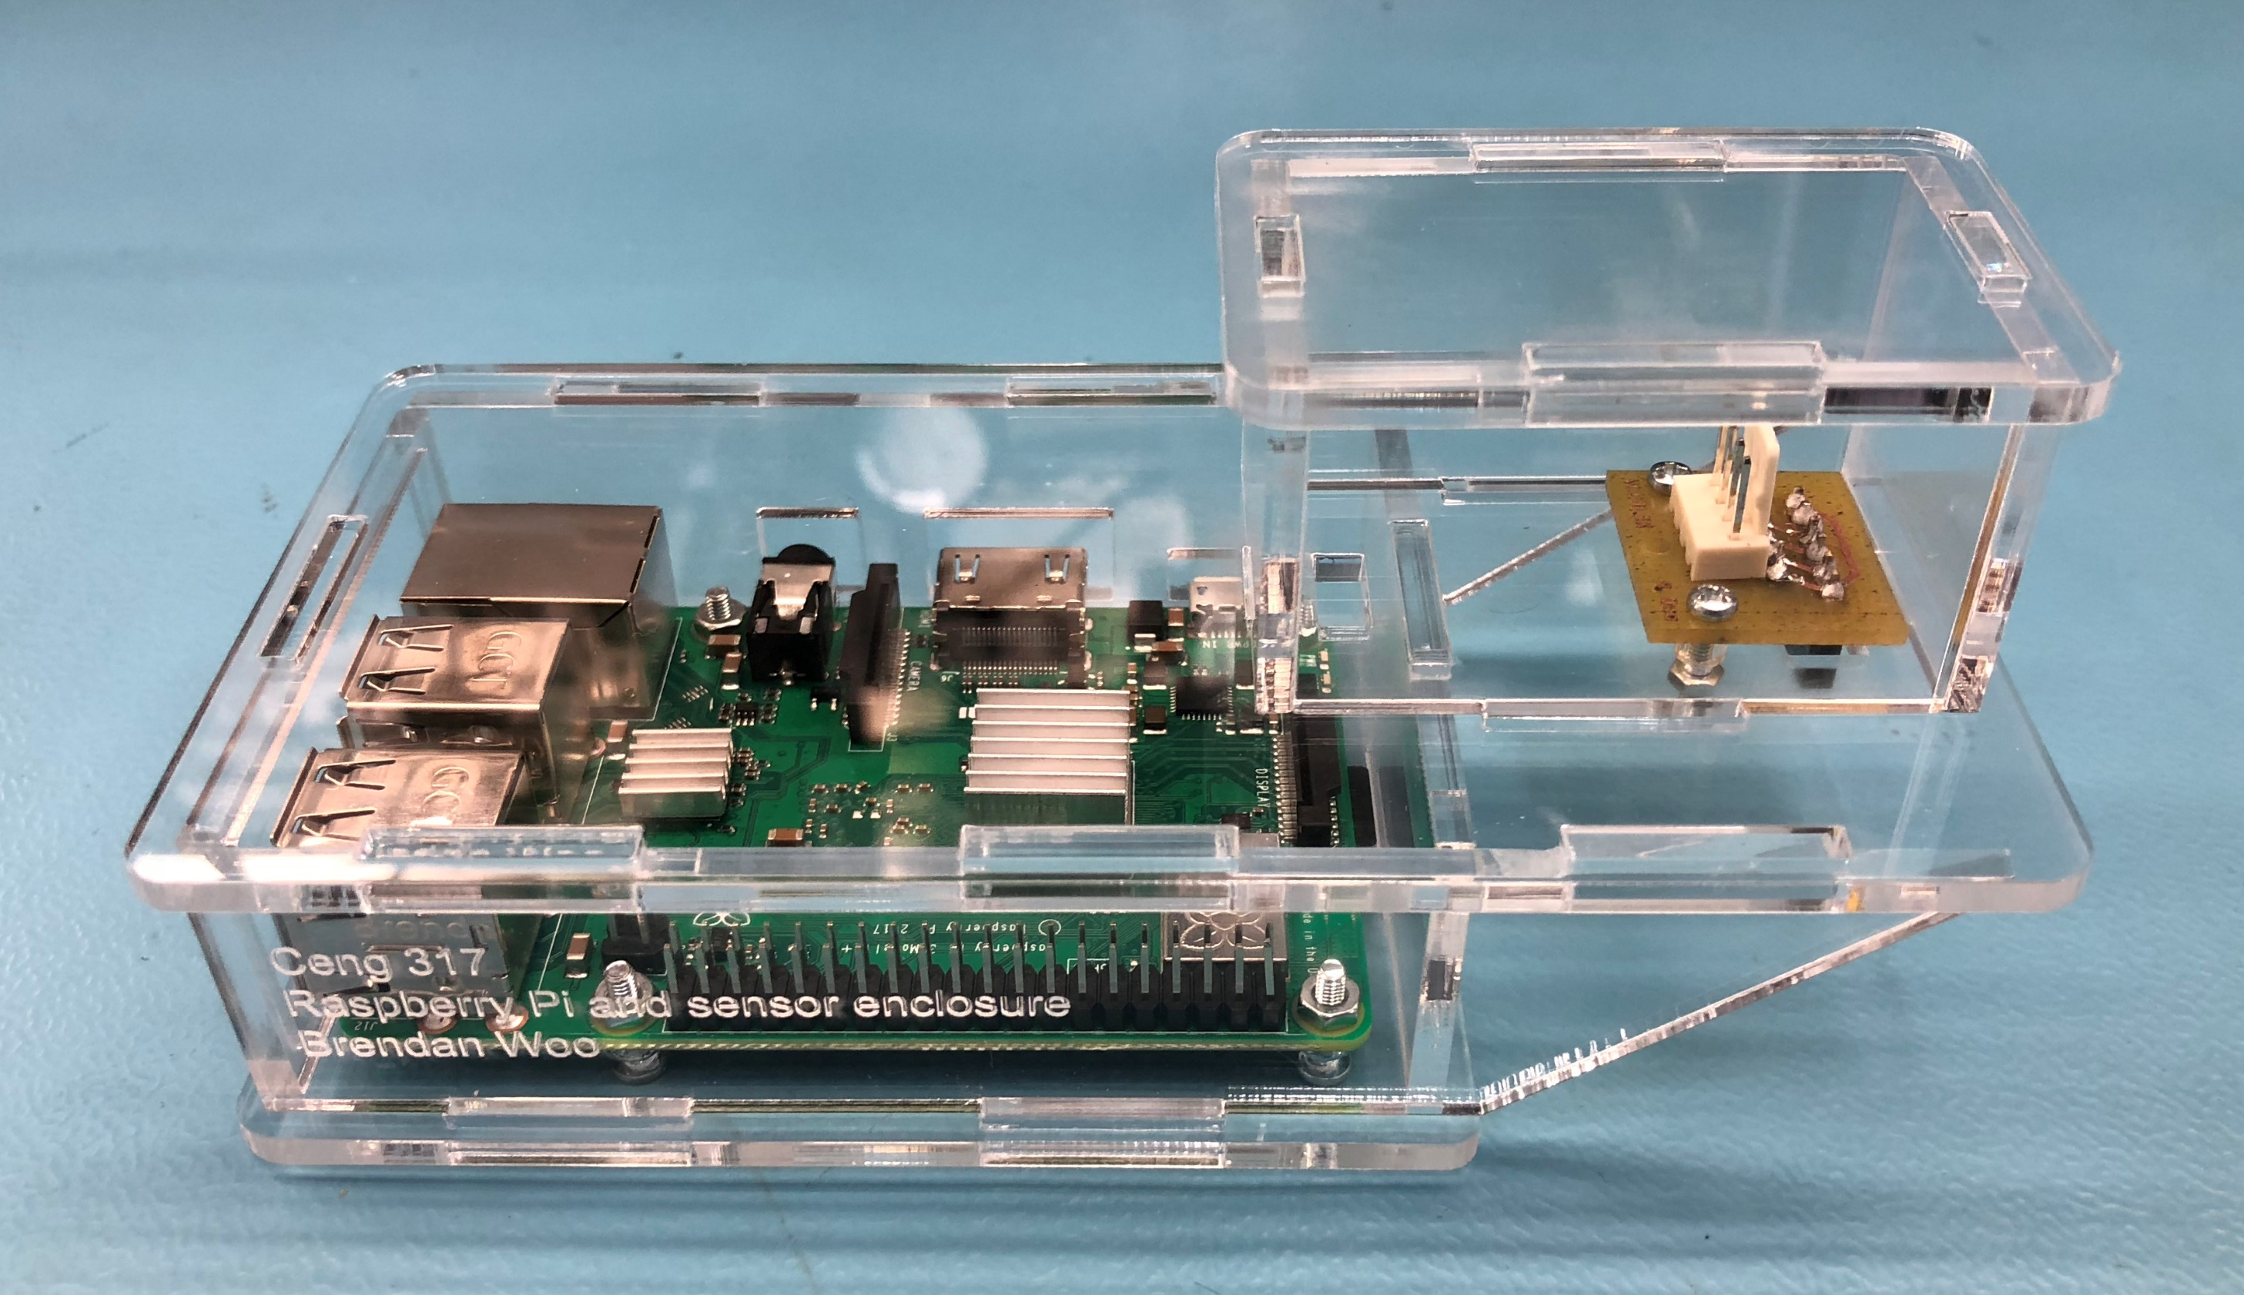
TOF sensor for Resistor Value Recognizer
Ceng 317
Brendan Woo

Slide 2
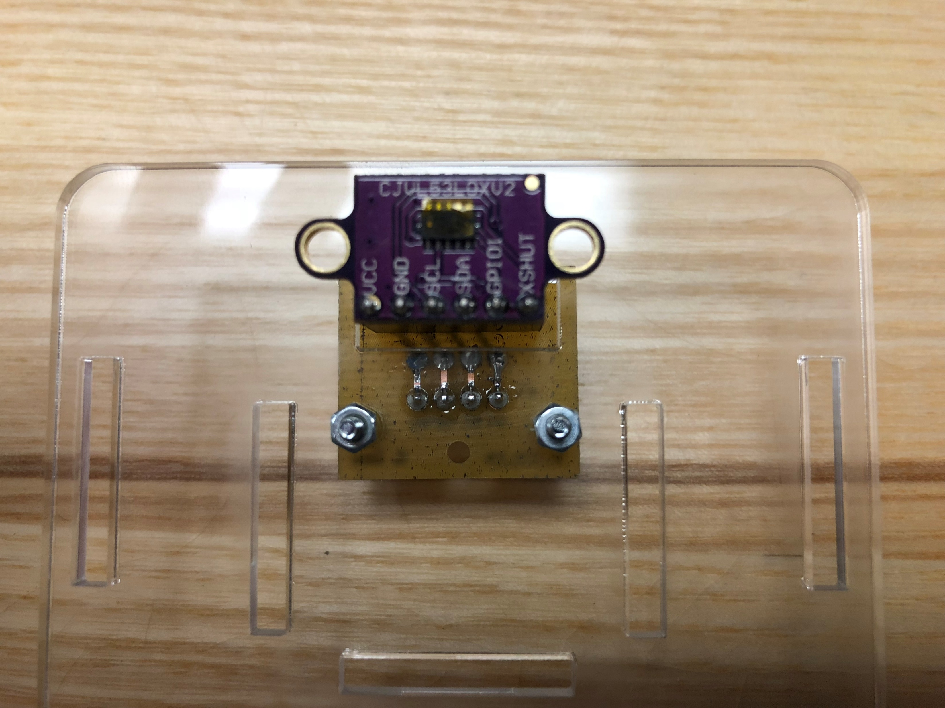
Proposal
The Capstone is a Resistor Value Recognizer to reduce traffic at the Parts Crib
The camera and lighting system must be
triggered by the insertion of a resistor
A Time of Flight infrared sensor will be used to
detect the movement for this purpose

Slide 3
Expenses
Original projected budget was $124.19
Many components were already acquired or supplied by the Prototype lab:
As a result, final expenses were $105.89
Total expenses during the course of the project were $5.57
Purchase | Cost | Number | Total cost | Notes | Status | Source
VL53L0X TOF sensor | $14.95 | 1 | $ 14.95 |  | Previously purchased | https://www.adafruit.com/product/3317
23x11 3mm transparent cast acrylic | $11.30 | 1 | $ 11.30 | For case | No cost | Supplied by prototype lab
Standoffs M-M (x4) | $2.50 | 1 | $ 2.50 | For case | No cost | Supplied by prototype lab
Standoffs M-F (x2) | $1.50 | 2 | $ 3.00 | For case | No cost | Supplied by prototype lab
Screws | $1.50 | 1 | $ 1.50 | For case | No cost | Supplied by prototype lab
Wires | $0.00 | 0 | $ - |  | Previously purchased
Header pin and connectors | $ 5.57 | 1 | $ 5.57 |  |  | Sayal
Raspberry Pi kit | $ 85.37 | 1 | $ 85.37 | Current price is lower | Previously purchased | https://www.amazon.com/CanaKit-Raspberry-Complete-Starter-Kit/dp/B01C6Q2GSY
Expected budget | $124.19
Total | $105.89
Total project-specific | $5.57

Slide 4
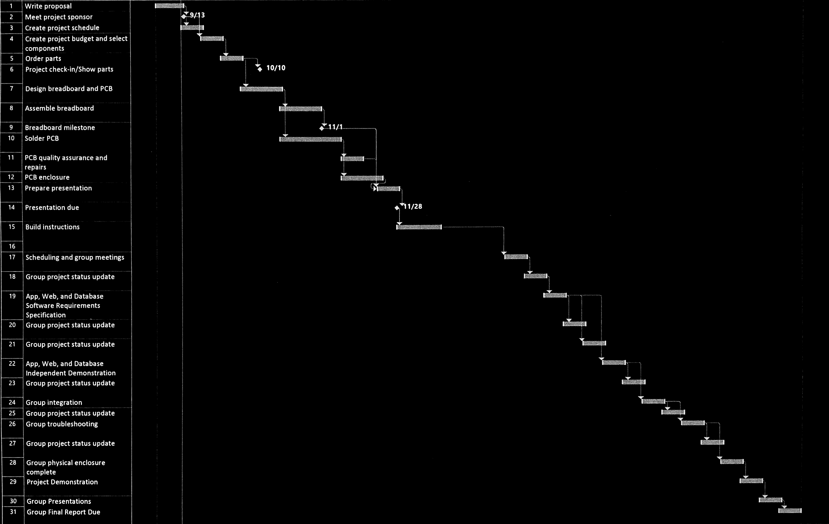
Schedule
Proposal
Schedule
Budget
Breadboard milestone
PCB milestone
Enclosure milestone
Presentation
Build instructions

Slide 5
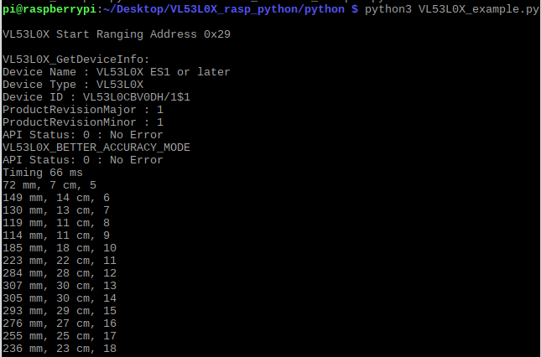
Final Product

Slide 6
Applied Knowledge
Tech 150: Electronic Devices and Circuits
Soldering, breadboarding, circuit troubleshooting
Ceng 252: Embedded Systems
Prototyping and programming on Raspberry Pi development platform
Ceng 215: Digital and Interface Systems
Sensor control and interfacing

